Slide 1
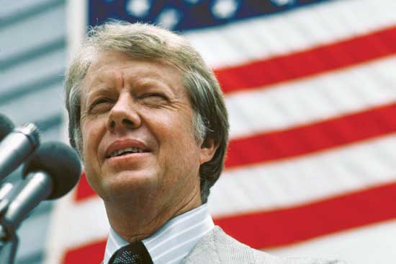
Jimmy Carter
39th President of the United States

Slide 2
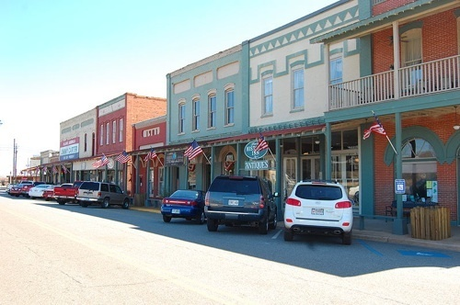
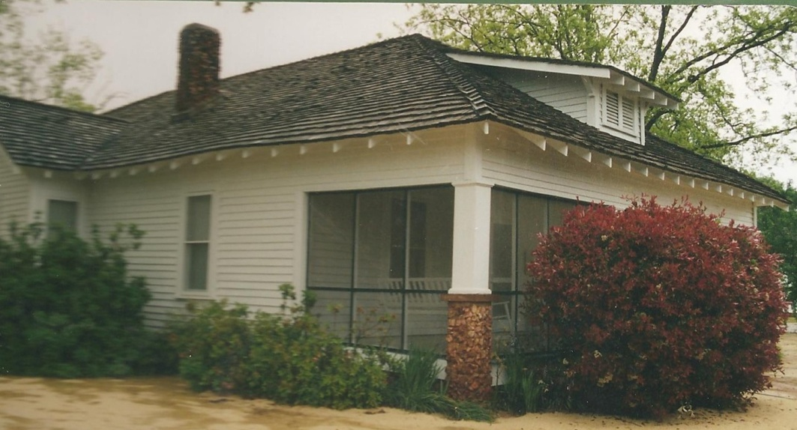
James Carter was born October 1, 1924.
His family moved near Plains, Georgia when Jimmy was four.

Slide 3
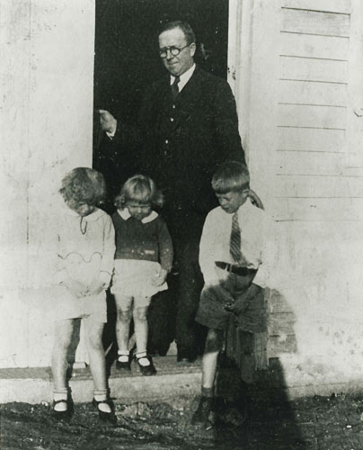
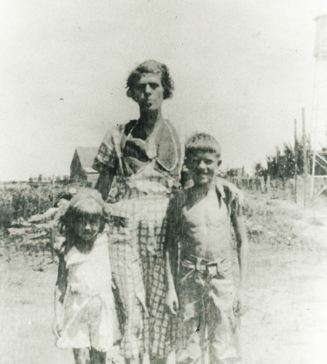
Jimmy Carter’s father , Earl, was a successful farmer. He also owned a general store.
His mother, Lillian, was a nurse.

Slide 4
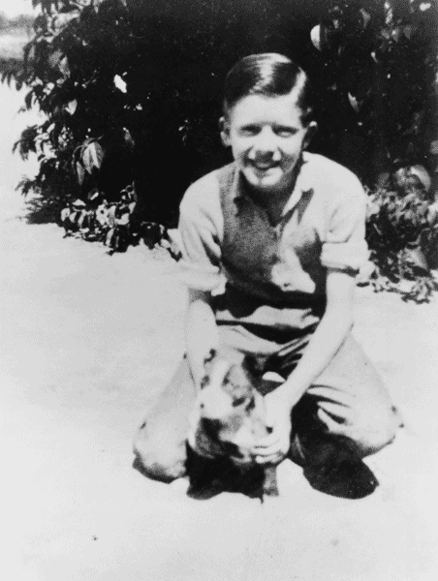
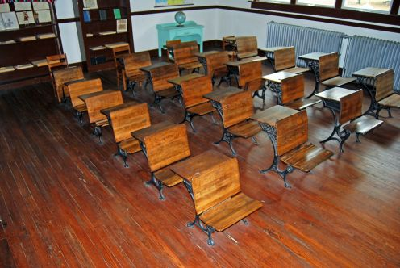
Jimmy Carter went to the same school from elementary school until he graduated.
Like most children, Jimmy enjoyed spending much of his time outdoors.

Slide 5
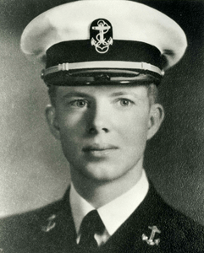
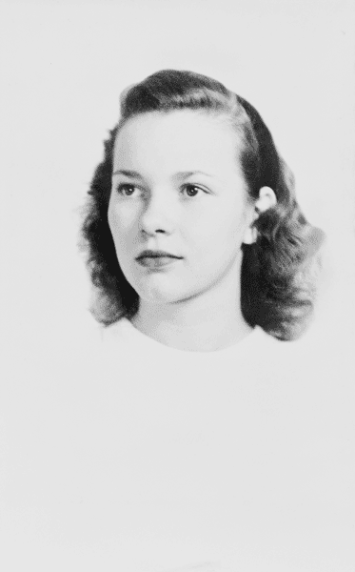
On July 6, 1946, he married Rosalynn Smith.
Jimmy Carter attended Georgia Southwestern University and Georgia Tech. But he was most proud of graduating from the Naval Academy in 1946.

Slide 6
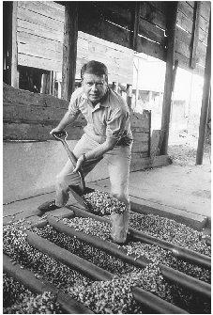
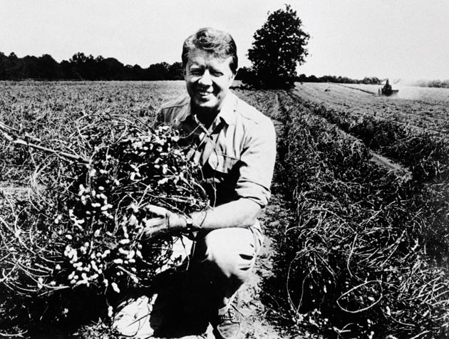
Jimmy Carter was a successful peanut farmer and ran the Carter Warehouse.

Slide 7
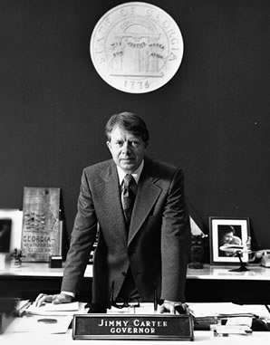
In 1970, Jimmy Carter ran for governor of Georgia and won.

Slide 8
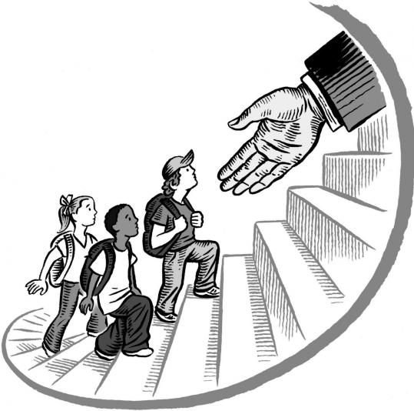
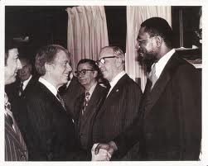
When Carter became governor, he worked to end segregation.
He worked to improve schools. He increased the number of black Americans working in government.

Slide 9
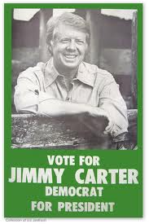
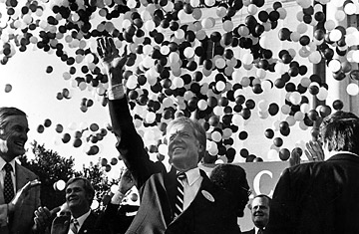
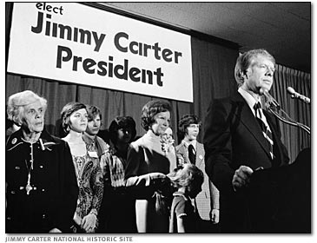
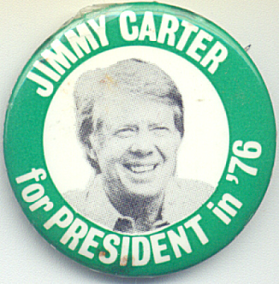
Then Jimmy Carter decided to run for President of the United States.

Slide 10
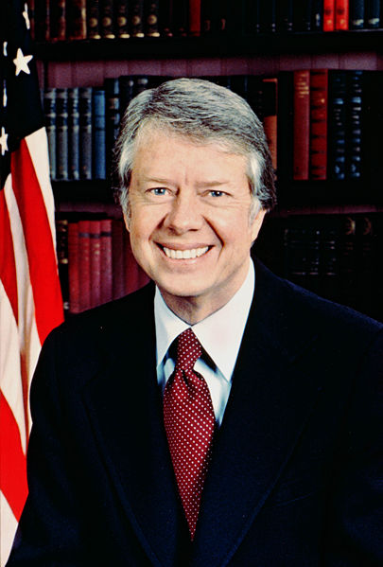
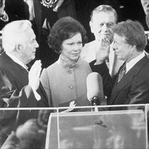
James Earl Carter became the 39th president of the United States on January 20, 1977.

Slide 11
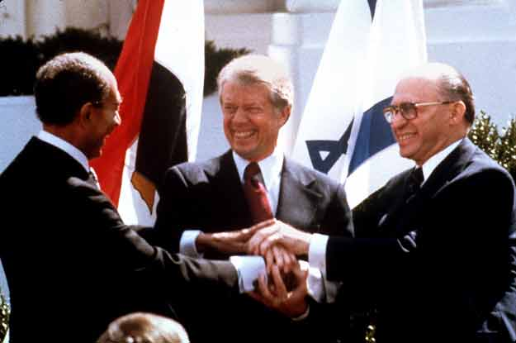
As president of the United States, Jimmy Carter was deeply committed to social justice and basic human rights. He worked to bring peace in the Middle East.

Slide 12
President Carter worked hard to protect the environment. He signed a bill called the Alaska National Lands Conservation Act, which protected over a hundred million acres of land in Alaska.

Slide 13
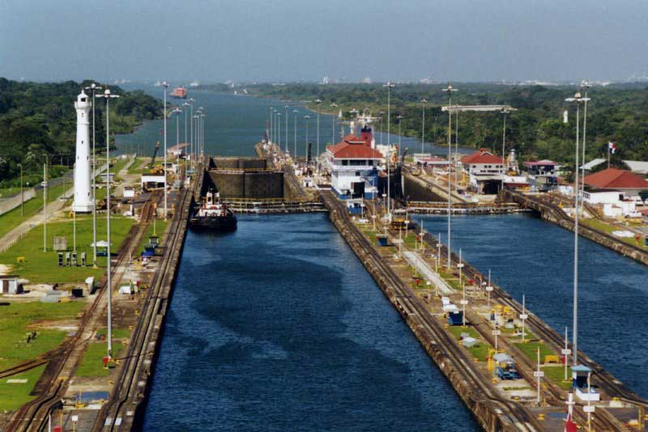
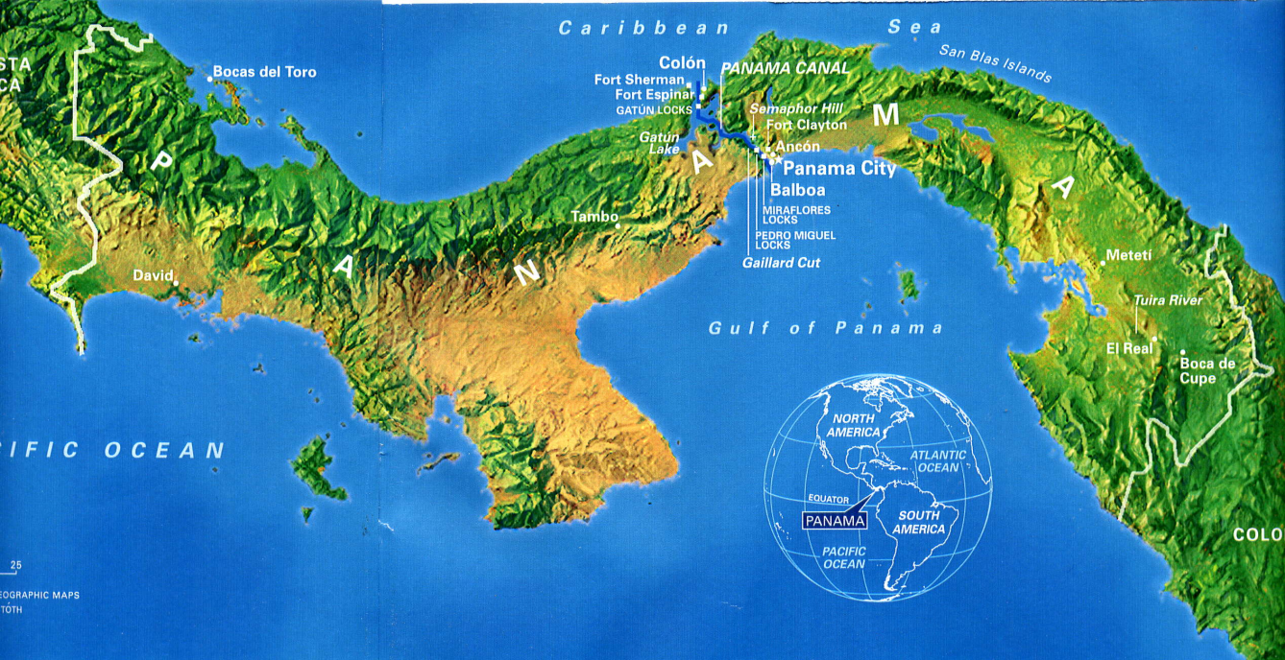
President Carter also signed the Panama Canal Treaties, which gave the Canal to the Panamanian people.

Slide 14
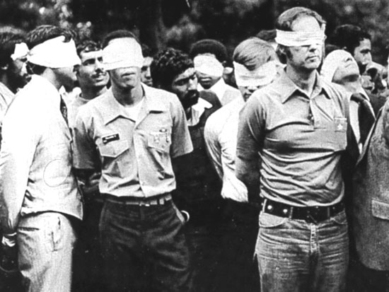
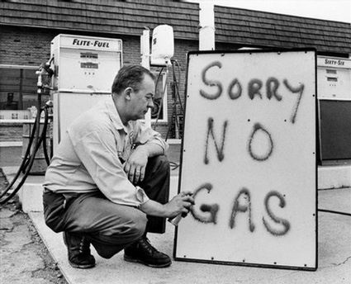
There were problems during Carter’s term. Iranian Revolutionaries kidnapped and held 52 Americans for 444 days.
There was a shortage of oil, causing people to wait in long lines to get gas for their cars.

Slide 15
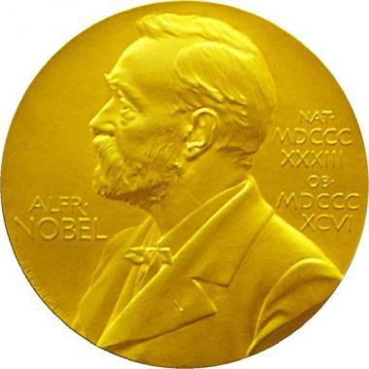
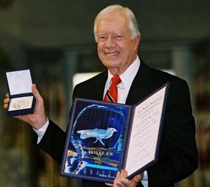
In 2002, James Earl Carter was awarded the Nobel Peace Prize …
“for his decades of untiring effort to find peaceful solutions to international conflicts, to advance democracy and human rights, and to promote economic and social development.”

Slide 16
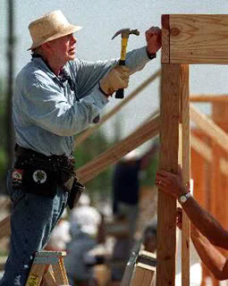
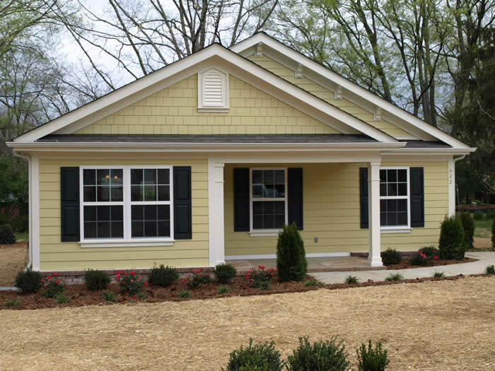
Habitat for Humanity partners with working families, sponsors and communities to build affordable, green, quality homes and to provide services to help people buy and live in these homes. Jimmy Carter has worked with this organization since 1984.

Slide 17
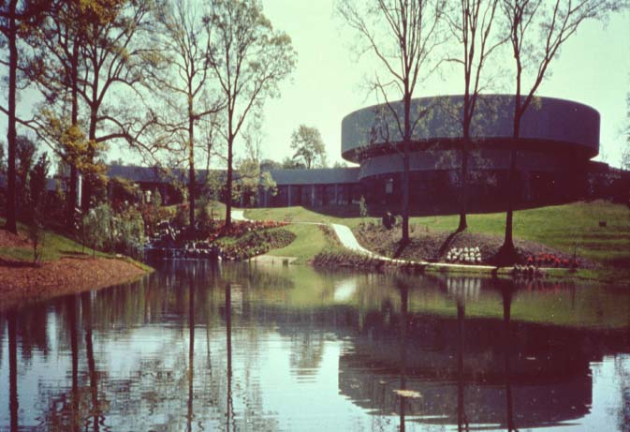
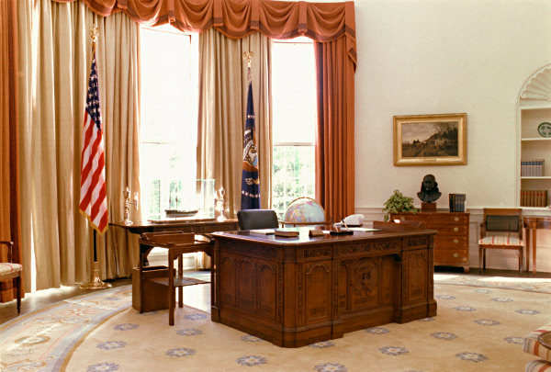
The Carter Center mediates disputes between countries, monitors elections, works to protect human rights, and fights disease and poverty around the world.
The Carter Library and Museum holds 27 million papers and a ½ million photographs from the Carter presidency. Among the exhibits is a replica of the Oval Office as it was when Carter was president.

Slide 18
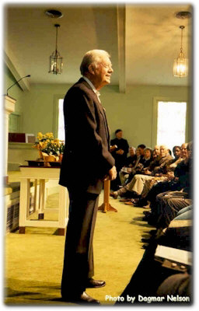
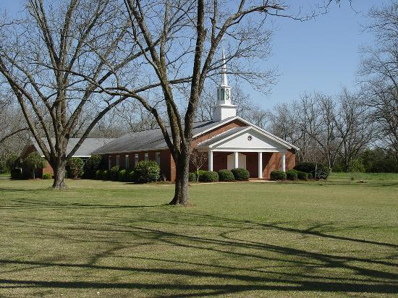
Today, Jimmy Carter spends his time working for the Carter Center, Habitat for Humanity and teaching Sunday School at Maranatha Baptist Church, in Plains, Georgia.

Slide 19
Resources
http://www.jimmycarterlibrary.gov/documents/jec/jecbio.phtml
http://www.achievement.org/autodoc/page/car0bio-1
http://www.cartercenter.org/news/experts/jimmy_carter.html
http://www.whitehouse.gov/about/presidents/jimmycarter
http://www.biography.com/people/jimmy-carter-9240013?page=3
http://www.jimmycarter.info/justforkids_4.htm
http://www.jimmycarterlibrary.gov/information/
http://www.plainsgeorgia.com/
http://www.nps.gov/jica/index.htm

